Slide 1
PF FINAL PROJECT
BANK ACCOUNT MANAGEMENT SYSTEM
JAWWAD AHMED 22k-4648
HAFEEZ 22k-4630

Slide 2
PROJECT PROCESSING
LIBRARIES
IF ELSE
LOOPS
ARRAY
STRUCTURE
FUNCTION
POINTERS
FILING

Slide 3
Function Use In Project
void transfermoney(int,int);[This Function Play A Role Of Deposit and
Withdrawing]
void logout(void);This Function Doing process Of Loggout]
void loginsu(void)This Function print the Message Of Login]
void account(void);This Function Collect The Data Of User]
void ACC_created(void);Function Print The Message Of Generating ACOU]
void balance_checker(char*);[Function Show The Money In Account]
void LOGin(void);[Function Take A User Name and Password Of ACCOUNT]
void ACC_VIWER(char*);[Function Print the State of Account]
void gotoxy(int x, int y);[Funtion Control The Cursor]

Slide 4
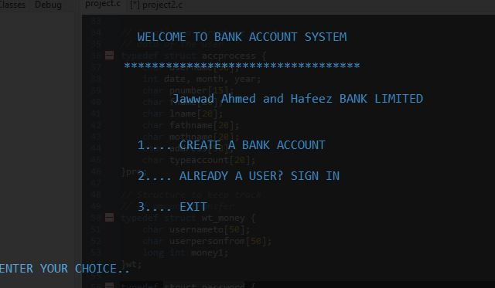
STRUCTURE
struct accprocess Taking The Data Of User and Store It
struct wt_money Take The AMOUNT For Withdraw and Deposit
struct password Store User PassWord

